Slide 1
Energy Storage and PHEVs Analysis with GridLAB-D

Slide 2
Course Overview
Part 1: Overview of Energy Storage
Part 2: Energy Storage in GridLAB-D
Part 3: PHEVs in GridLAB-D

Slide 3

Part 1: Overview of Energy Storage

Slide 4
Types of Energy Storage
Energy Storage devices store electricity in the form of potential energy
  Battery Storage devices store electricity in the form of chemical potential energy
Reservoir Storage
  Compressed Air Energy Storage (CAES)
  Pumped Hydro Storage
Mechanical Storage
  Flywheel
Thermal Storage
  Heat Pump
  Hot water heater
Batteries
  Flow Battery (VRB)
  NaS Battery
  Lithium Ion Battery
  Lead Acid Battery
  Hydrogen and Fuel Cells (Zinc Bromide Flow Cell Battery- ZESS)

Slide 5
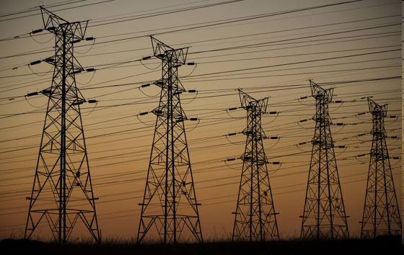
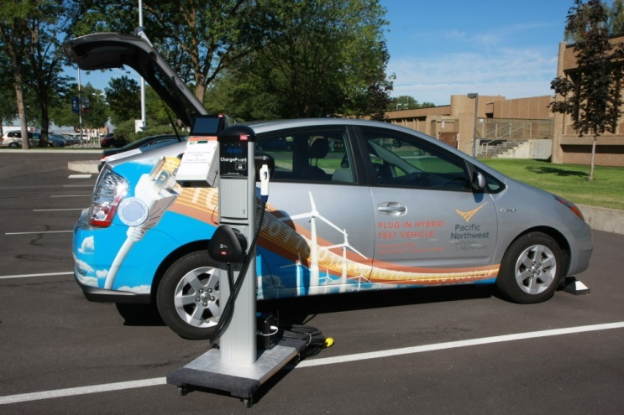
Applications of Energy Storage
Transmission Level Energy Storage
  Provide regulating services for intermittent renewables
  Mange peak demand
  Provide black start capabilities
Distribution Level Energy Storage
  Provide regulating services for intermittent renewables
  Mange peak demand
  Provide power during blackouts

Slide 6
Some Major Battery Storage Systems
NaS Battery (Sodium Sulfur)
VRB Flow Battery (Vanadium Redox Battery)
ZESS Battery (Zinc Energy Storage System)

Slide 7
NaS Batteries
How It Works: It consists of sulfur at positive electrode, sodium at negative electrode, and Beta alumina of sodium ion conductive ceramic which separates the electrodes. During the charge, the electric power supplied from outside form sodium in negative electrode and sulfur in positive by following the reverse process of discharge. Because of this, energy is stored in the battery.
Capacity: 25-250 kW per battery bank (Pro)
Efficiency: 65 - 75% (Pro)
Life Expectancy: 15 years/4,500 cycles (Pro)
Environmental: No appreciable air, waste, or sound emissions are produced (Pro)
Maintenance: Every 3 years; Inexpensive (Pro)
Cost: $4,500/kWh (Con)
Energy Density: 190 Wh/kg (Pro)

Slide 8
NaS Battery Projects/Installations
Japan Wind Development- 51 MW wind farm that incorporates a 34 MW NaS battery system
Hokkaido Electric Power Co. Inc- 5 MW solar photovoltaic array that incorporates a 1.5 MW NaS battery system
American Electric Power, West Virginia and Ohio service territories- started small-scale testing of NaS batteries in 2002; since then, they have expanded use, aiming to install 25 MW of NaS to their systems in the next decade
Xcel Energy, Minnesota- currently testing wind farm energy storage based on 20-50kW NaS batteries from NGK

Slide 9
Vanadium Redox Batteries
How It Works: Energy is stored chemically in different ionic forms of vanadium in a dilute sulfuric acid electrolyte. The electrolyte is pumped from separate plastic storage tanks into flow cells across a proton exchange membrane (PEM) where one form of electrolyte is electrochemically oxidized and the other is electrochemically reduced. This creates a current that is collected by electrodes and made available to an external circuit. The reaction is reversible allowing the battery to be charged, discharged and recharged.
Capacity: Depending on size, 5kW-120kW per battery bank (Pro)
Efficiency: 65% (Pro)
Life Expectancy: 7-15 years/10,000 cycles (Pro)
Environmental: No appreciable air, waste, or sound emissions are produced (Pro)
Maintenance: Quarterly or annual maintenance, periodic part replacement every 5 years (Con)
Cost: Depending on size, $300-650/kWh (Pro)
Energy Density: 40 Wh/kg (Con)

Slide 10
VRB Projects/Installations
Tapbury Management- 12kWh for Irish wind farm
PacifiCorp (Castle Valley, Utah)- 2800 kWh (3 years of successful operation)
Pinnacle- 30kWh for Remote Area Power Supply (RAPS) in Australia
Magnetek (Menomonee Falls, WI) - Plans to install eighty 5kW systems
RisØ - 120 kWh, Danish wind applications
Eskom- 10kWh for back up substation of major South African utility
Solon AG- 10kWh solar applications in Germany
South Carolina Air National Guard- 30 120kWh back up power
National Research Council of Canada- 10kWh for RAPS
Ben Gurion University, Israel- 20 kWh back up power

Slide 11

Zinc Energy Storage System Batteries
How It Works: The ZESS relies on a flowing electrolyte system. The predominantly aqueous electrolyte is composed of zinc bromide salt dissolved in water. During charge, metallic zinc is plated from the electrolyte solution onto the negative electrode surfaces in the cell stacks. Bromide is converted to bromine at the positive electrode surface of the cell stack and is immediately stored as safe, chemically complexed organic phase in the electrolyte tank
Capacity: 50 kWh or 500 kWh per battery bank, depending on model (Pro)
Efficiency: 65-75% (Con)
Life Expectancy: 10-20 years/2,000 cycles (Pro)
Environmental: No appreciable air, waste, or sound emissions are produced (Pro)
Maintenance: Remote monitoring, annual inspections, maintenance items still to be developed (Con)
Cost: $400/kWh (Pro)
Energy Density: 85 Wh/kg (Con)

Slide 12
ZESS Projects/Installations
Beijing Olympics- ZESS 50 provided they key energy storage element in the Zero Net Energy, Future House USA home on display from August 2008-August 2014
Dundalk Institute of Technology (DIT), Ireland- ZESS 500 will be used in DIT’s Center for Renewable Energy Project
Oregon State University- ZESS 50 will be used on campus at the Wallace Energy Systems and Renewables Facility
Envision Solar (Cote d’Ivoire, Africa)- ZESS 50 will be incorporated with PV panels for the LifeVillage Project
ZESS batteries are currently undergoing testing at Pacific Gas and Electric (California), Detroit Edison (Michigan), United Energy Limited (Melbourne, Australia), and Sumitomo Corporation (Tokyo)

Slide 13
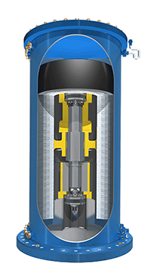
Flywheels
Flywheels store energy in the form of rotational kinetic energy.
Beacon Power sells a 25 kWh unit.
Multiple units can be used to provide a transmission level resource.

Slide 14
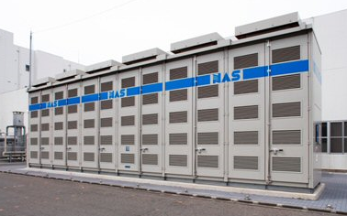
Part 2: Energy Storage in GridLAB-D
Central – Larger units placed at the substation or on the primary distribution system.
Distributed – Smaller units placed at the secondary service transformers.

Slide 15
Battery
object battery {
parent meter1;
name battery_1;
generator_mode CONSTANT_PQ;
V_Max 2650;
I_Max 500;
P_Max 50000;
E_Max 250000;
base_efficiency 0.86;
parasitic_power_draw 10 W;
power_type DC;
generator_status ONLINE;
Energy 250000;
scheduled_power battery_schedule*13158;
power_factor 1.0;}
Batteries are in the “generators” module.
Must be connected to one of the following objects:
  Meter
  Triplex meter
  Inverter
Base_efficiency is a one-way efficiency.
There are currently multiple modes of battery operation, but due to the large number of possible operating strategies they are not complete.

Slide 16
Battery Control Modes
CONSTANT_V: Not working in any model at this time. This will allow the user to specify a regulating voltage and the model will attempt to maintain the voltage.
CONSTSNT_PQ: This allows the user to manually state the desired output/input of the battery (or other generator). In conjunction with “scheduled_power”, this allows the user to control the battery’s charge and discharge rates within their rated limits. Note 1: A negative scheduled power value equates to charging, while a positive equates to discharging. Note 2: Only the ‘P’ portion is working right now. Future implementations will include full PQ control.
CONSTAND_PF: Not working (only works in inverter at this time). Allows the user to schedule power at a specific power factor.
SUPPLY_DRIVEN: Only applies to models like solar & wind turbines that have variable fuel inputs. This essentially acts under IEEE-1547. The units are not allowed to regulate voltage, and their real power output is driven by fuel inputs such as wind and solar radiation. Wind model includes p.u. voltage dropouts.
POWER_DRIVEN: Only available in battery. This mode attempts to maintain the real power flowing through a meter object (which can represent the output of a transformer or line) within band set points, analogous to a voltage regulator. In conjunction with “power_set_high” and “power_set_low”, which define the upper and lower bands, the battery will adjust its charging / discharging to maintain itself within those bands while minimizing battery state changes. At the high and low points, it performs load following, while within the bands it sits idle.
VOLTAGE_CONTROLLED: Not implemented at this time. This is similar to CONSTANT_V, except the voltage is regulated within a voltage band (“voltage_set_high” and “voltage_set_low”). Full PQ control will be contained within this model.
POWER_VOLTAGE_HYBRID: Only available in battery on split phase systems. This is a merging of POWER_DRIVEN and VOLTAGE_CONTROLLED. The priority of this mode is to maintain power flowing through the meter, within the bounds of the voltage regulation set points (power set high, power set low, voltage set high, and voltage set low are all used). The battery first tries to maintain the power flowing through the meter, but will adjust itself only to the point where voltage regulation is maintained. For example, if the power mode requires that the battery charge, but the voltage is already low, then the battery will stay in idle mode.

Slide 17
Part 3: PHEVs in GridLAB-D
Communities PHEV

Slide 18
PHEV
object
It is a PHEV

Slide 19
Part 2: Energy Storage in GridLAB-D
Stuff

Slide 20
Part 3: PHEVs in GridLAB-D
Stuff

